Slide 1
Programming Methodology Lab2 #4 Git Working with Remote / GitHub
2019.04.10

Slide 2
Today’s TA
Main TA
Support TA
배현경 | hkbae@snu.ac.kr |  | jennybae1024@gmail.com
이윤형 | cpi1234@snu.ac.kr | cpi1234_1
이환희 | wanted1007@snu.ac.kr | gmpee7207
Notes:
Escape sequence: \를 앞에 붙여서 원래의 의미를 벗어나는 문자를 의미 (\r \\ \” 등)

Slide 3
Lab Objectives
Conflict
Working with Remote
Pull / Fetch & Merge
Push
Introduce to GitHub / Setup

Slide 4
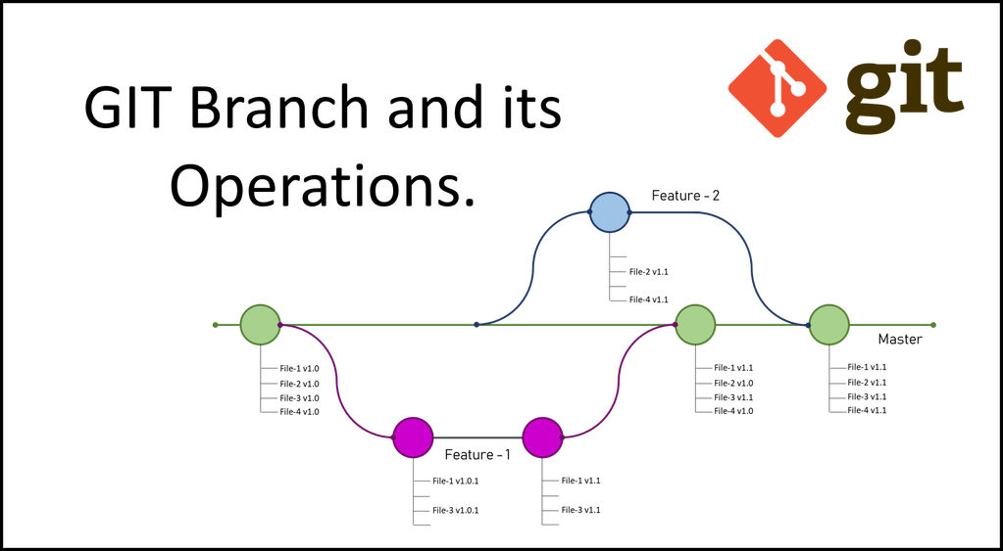
(Recall) Basic Branching and Merging
Branch: A line of development.

Slide 5
(Recall) Basic Branching and Merging
Master branch should be preserved without errors.
When you want to add features on master branch, first you have to make your own branch (Feature-1, my_branch ….)
After developing and validating your own branch, you now good to merge your branch to master branch.

Slide 6
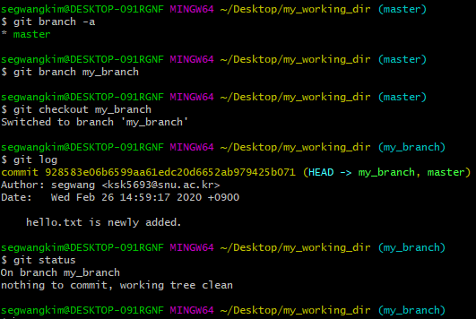
(Recall) Basic Branching and Merging

Slide 7
Git command
Git command related to branching
git branch [branch_name]
git branch –a
git checkout [branch_name]
git merge [branch_name]
git log --graph --oneline --decorate
git diff [(option)--color-words]
Notes:
Conflict 에 대해서 많은 질문을 받았고 오늘 수업을 해야하기 때문에
천천히 천천히 제 말을 듣고 따라해 보도록 하겠습니다.

Slide 8
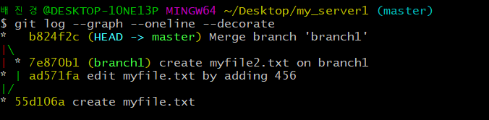
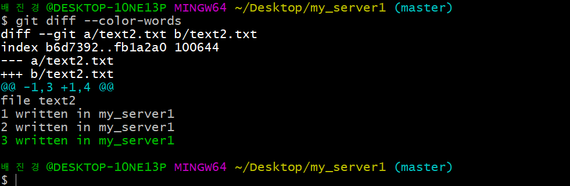
Git command
git log --graph --oneline --decorate
git diff [(option)--color-words]

Slide 9
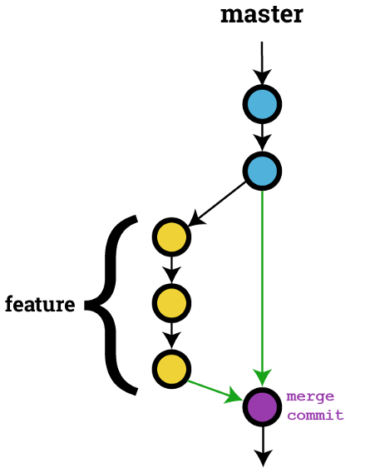
Conflicts
A conflict arises when two separate branches have made edits to the same line in a file.
Automatic merge cannot be performed when there are any ‘conflicts’ between branches.
myfile.txt
Hello world!
text.txt
myfile.txt
Hello world!
My github address is ...
Hello world!
My name is snu.
CONFLICT!!
Notes:
여러분 helloworld!! 라는 것을 만들고 master 에서 the second version 을 수정해보겠습니다.

Slide 10
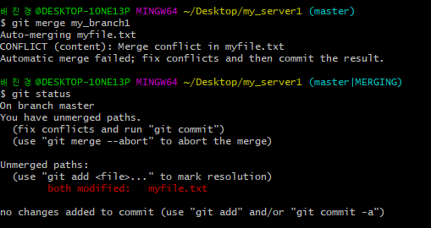
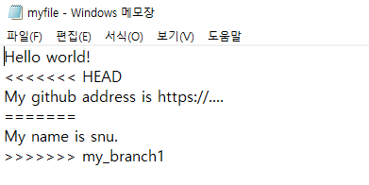
myfile.txt
myfile.txt
Hello world!
Hello world!
My github address is ...
master
?
my_branch1
myfile.txt
Hello world!
My name is snu.

Slide 11
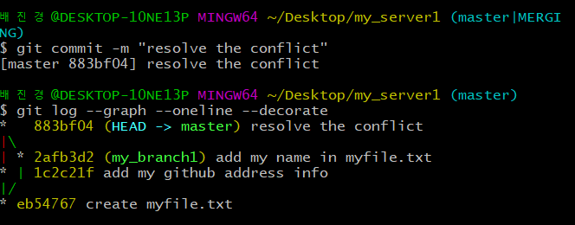
Resolving conflicts
To resolve conflict, modify files which caused conflict
In above case, ‘myfile.txt’
Modify the file manually, and then commit to master branch.
Hello world!
<<<<<<< HEAD
My github address is https://....
=======
My name is snu.
>>>>>>> my_branch1
version in HEAD (currently master)
version in my_branch1
Notes:
add: Register a change in an index
commit: Save the status of an index
pull: Obtain the content of a remote repository

Slide 12
Exercise #1
Simulate the conflict and resolve the conflict.
Create a new git repository. (folder name: my_server1)
Add a text file (myfile.txt) and commit in master branch.
Create a new branch (my_branch1).
Edit myfile.txt in both branch.
Checkout to master branch and merge with the other branch.
Resolve any conflicts if occur as modifying the file which caused conflict.
Notes:
자 여기까지 한 번 Exercise 하는 시간을 가져보도록 하겠습니다.

Slide 13
Exercise #1
myfile.txt
myfile.txt
myfile.txt
Hello world!
Hello world!
My github address is ...
Hello world!
My github address is ...
My name is snu.
master
branch1
git init
git add .
git commit –m “MESSAGE”
git branch [branch_name]
git checkout [branch_name]
git merge [branch_name]
myfile.txt
Hello world!
My name is snu.

Slide 14
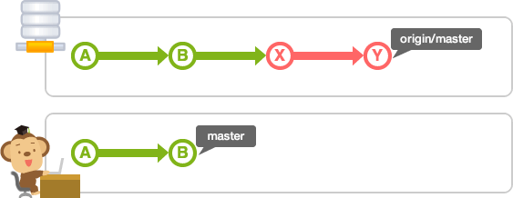

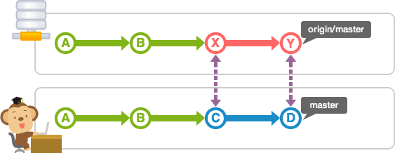
Working with remotes
Clone the remote repository.
Fetch or Pull from your remotes
Push to your remotes
master
remote server
pull or fetch&merge
clone
master
local server

Slide 15
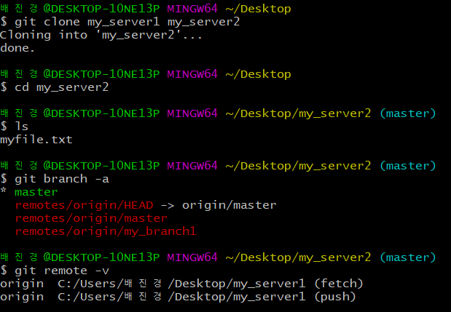
Clone the remote repo
You can clone an existing git repository into your workspace, and see which remote servers you have configured.
git clone [URL_or_PATH] [(OPTION)Target_directory]
git remote -v
master
my_server1
clone
master
my_server2

Slide 16
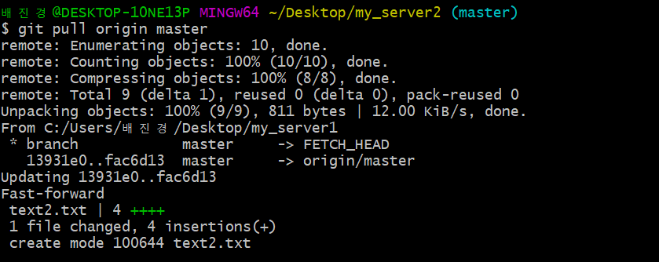
Pull or Fetch from your remotes
If your local repository has been cloned from remotes, keep up to date with the remote using following operations
Two steps are needed
1) fetch new works from remotes
2) merge with current branch
git pull [remote_name] [current_branch]
+
git pull
Notes:
remote 에 대해서 알아볼 텐데, 처음으로는 일단 Pull 에 대해서 먼저 알아보도록 하겠습니다.
원래의 original repository 가 현재 myRepo 라는 디렉토리에 있는 것이고, 여러분은 지금 그 repository 를 clone 해서 왔기 때문에
자동으로 clone repository 에서 작업을 하면 local repository(원숭이가 있는) 가 되는 것입니다.
원래는 제가 뒤에서 나올텐데 remote 를 직접 Add 해서 걸어줘야 하는데, 일단 여러분이 clone 을 했다면 자동으로
다음처럼 origin 이라고 하는 remote 가 연결되어 있는 것을 확인할 수 있습니다.
일단 Pull 을 해보기 전에 원래 repository 에서 history 수정을 한 번 해보겠습니다.
New Text 를 하나 만들고 Add commit을 해보도록 할게요.

Slide 17
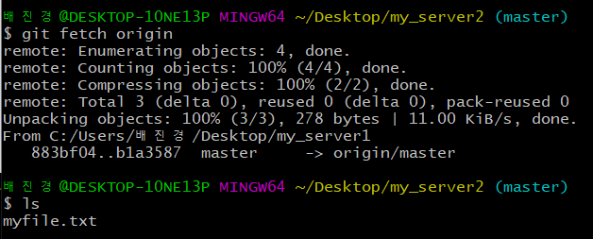
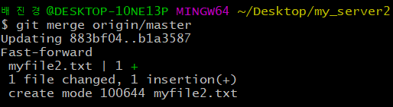
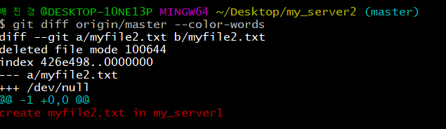
Pull or Fetch from your remotes
git fetch command only downloads the data to your local repo.
You have to manually merge the changes.
git fetch [remote_name]
git merge [remote_name]/[current_branch]

Slide 18
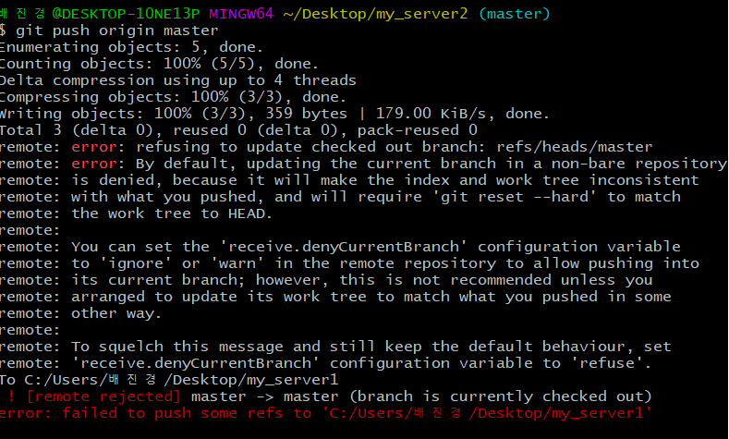
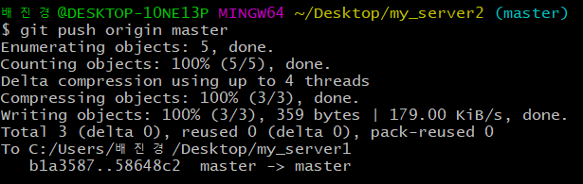
Push to your remotes
git push [remote_name] [uploading_branch]
In remote repository, HEAD should be in the branch with the different name with uploading branch
When HEAD in remote repo is in the branch with same name as current local branch.
When git push succeeds
Notes:
여기서 중요한게 만약 push 당하는 original repo 에서 current branch 가 push 하려는 clone 의 branch 와 이름이 같으면 안됩니다.
현재 push 하려는 대상인 clone repository 에서 master 가 current branch 이기 때문에, original repository 에서는 issue1 이나 다른 이름의
Current branch 여야만 push 가 가능합니다. 참고로, 만약에 push 하려는 clone repository 에 있는 branch 이름이 original repository 에 없다면
Original repository 에 branch 가 자동으로 생깁니다.

Slide 19
Exercise #2
Create my_server2 git repo by cloning my_server1.
Make a change in my_server1 and commit. (Add myfile2.txt)
Pull (or fetch/merge) the changes made in my_server1 (Edit myfile.txt or create a new file).
Make a change in my_server2 and commit. (Edit myfile.txt)
Push the change to my_server1.
master
2
my_server1
1
clone
pull or
fetch&merge
push
3
5
master
my_server2
4

Slide 20
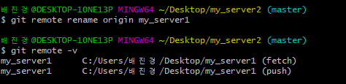
Add another remote
When working with two or more remotes, additional remote can be defined
git remote add [remote_name] [url_or_path]
If your local repo has been cloned from the remote, that remote is added as ‘origin’ by default.
git remote rename [current_name] [new_name]
Notes:
마지막으로 Add 입니다.
일단 Repository 로의 Add 를 먼저 설명 드리고 github 는 나중에 설명 드리도록 하겠습니다.

Slide 21
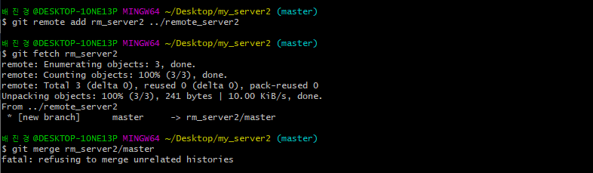
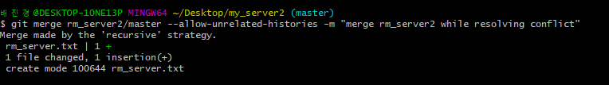
Issues when merge remote repo
Please search error on GOOGLE first!!
e.g) git merge my_branch1/master --allow-unrelated-histories
Notes:
마지막으로 Add 입니다.
일단 Repository 로의 Add 를 먼저 설명 드리고 github 는 나중에 설명 드리도록 하겠습니다.

Slide 22
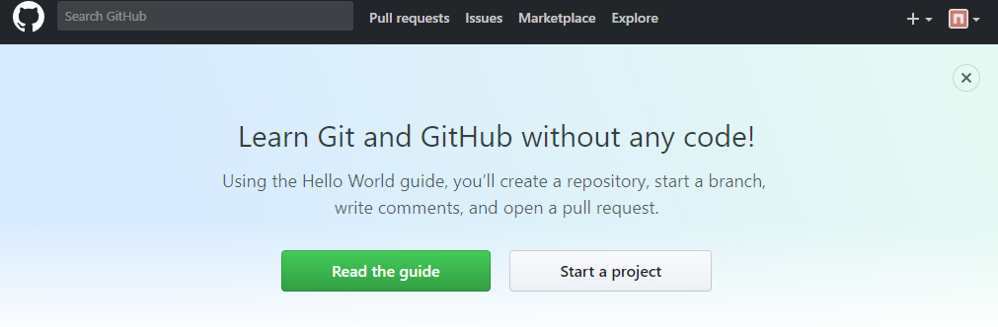
Introduce to GitHub
The single largest host for Git repositories
A large percentage of all Git repositories are hosted on GitHub, and many open-source projects use it for Git hosting, issue tracking, code review, and other things

Slide 23
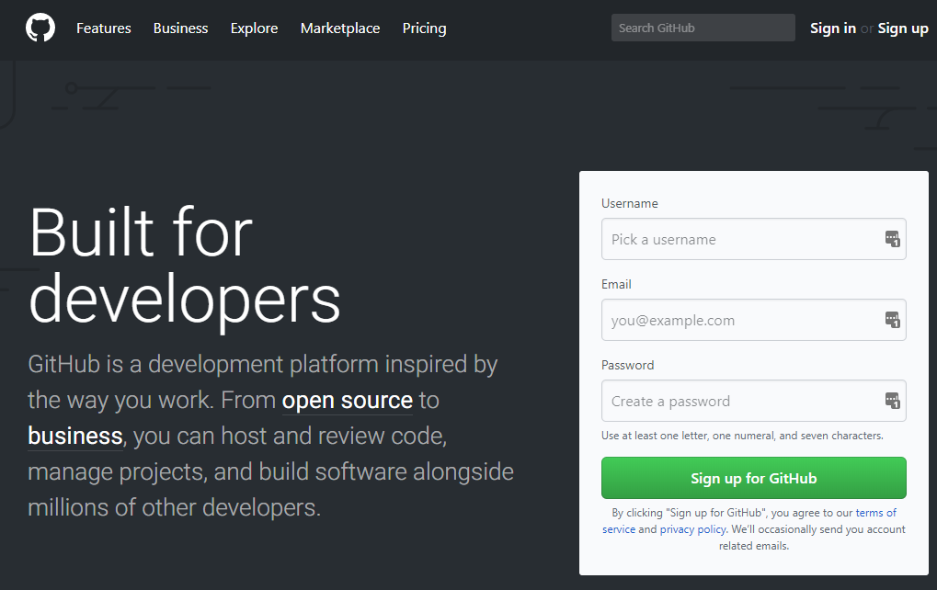
GitHub Setup
Create account (https://github.com/)
Choose username and password, then enter your e-mail address.
Confirm e-mail to activate your account
Update your profile if necessary
Sign in to the Github, then go to ‘Settings’ menu on top

Slide 24
GitHub Setup
SSH keys / E-mails
Only permissioned user can push to your repository
User is identified by SSH key (unique to each PC) and e-mail, so your key and working e-mail (other than account e-mail) should be added
We can generate SSH key in GIT BASH
Notes:
SSH key 라는 것에 대해서 들어보신 분도 있고, 네트워크 관련되서 아직 2학년이라서 못 들어보신 분도 많을 거라고 생각이 되는데,
Secure Shell protocol 로 네트워크에서 데이터 전송과 원격 제어에 관련해서 상호간의 보안을 제공하는 프로토콜이라고 생각하시면 됩니다.
예 어쨌든 github settings 에서 ssh key 를 등록해보도록 하겠습니다.

Slide 25
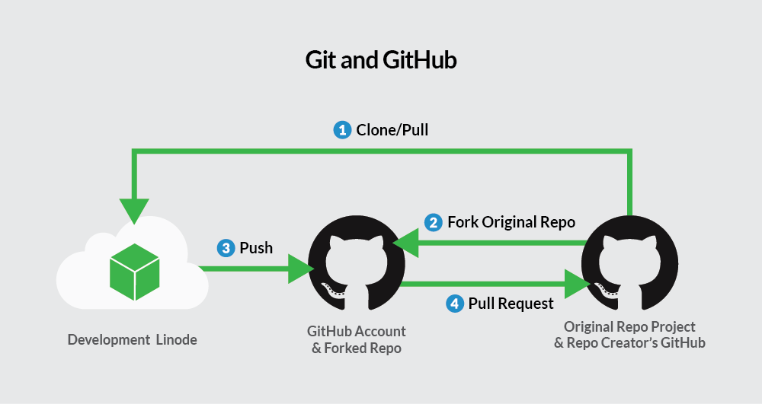
Contributing to a GitHub Project
Unless you’re working as one of the core developers in a project (able to push to the repo directly), participating in a GitHub project starts from forking (copying) the repo to your account
Create a topic branch in the forked repo, and make changes
If modifications done, a pull request could be issued to merge your branch into the original project
Image courtesy of https://linode.com/docs/development/version-control/how-to-install-git-and-clone-a-github-repository/
Notes:
만약 여러분이 어떤 프로젝트의 핵심 개발자라서 repository 에 직접적으로 push 할 수 있는 권한이 없다면,
여러분이 만약 github 를 이용하여 어떤 프로젝트에 참여를 하고 싶다면 일단 fork 를 먼저 해야 합니다.
Fork 한 repository 에서 branch 를 만들고 작업을 합니다. 그리고 pull request 를 통해서 original project 에
여러분이 작업한 branch 를 merge 할 것을 요구할 수 있습니다.

Slide 26

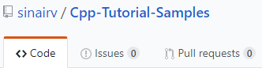
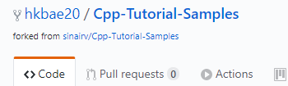
Contributing to a GitHub Project
Forking a project
Click ‘Fork’ button on GitHub page will fork the project into your account
Resulting project indicates that it is a forked project
Original
Forked
Notes:
간단하게 github 에 있는 fork 버튼을 이용해서 project 를 fork 할 수 있고,
그러면 왼쪽의 original repository 가 sinairv/Cpp-Tutorial-Sample 이라면
Fork 했을 때 다음처럼 fork 했다는 branch 모양과, forked from sinarv/Cpp-tutorial-smaples 라는
것이 생기는 것을 확인할 수 있습니다.

Slide 27
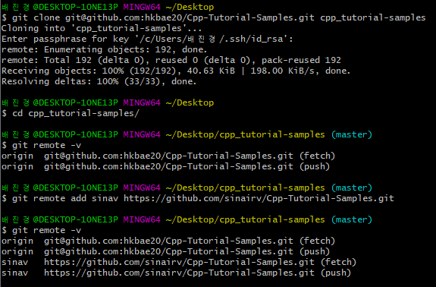
Contributing to a GitHub Project
Clone the forked project to your local repo and add “original”
To pull the changes from the “original” repo, add the repo to remote (forked repo is already added as “origin”)

Slide 28

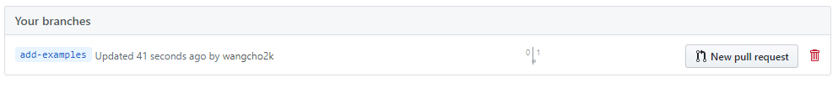
Contributing to a GitHub Project
Make changes and push to your forked repo
First create a topic branch which you will work in
Modify the code as you want, then commit and push to ‘forked’ repo
Create a pull request
Go to the forked project in GitHub
Click ‘branches’
Locate your topic branch and click ‘New pull request’

Slide 29
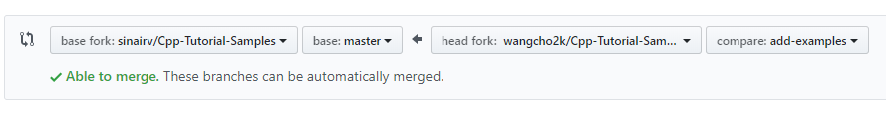
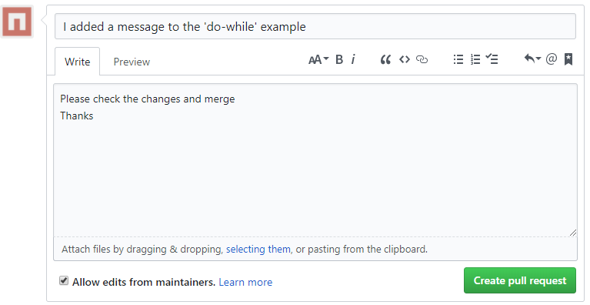
Contributing to a GitHub Project
Create a pull request
Make sure that your topic branch is merging into original’s master
Add message and click ‘Create pull request’

Slide 30
Attendance Check Coding (~15:00, Apr 05)
Basic Conflict resolution
myfile.txt
myfile.txt
myfile.txt
Hello world!
My name is hkbae.
My student number is 2020-20260.
Goodbye.
Hello world!
Hello world!
My name is hkbae.
master
[NAME]
[STUDENT NUM]
myfile.txt
myfile.txt
Hello world!
Goodbye.
Hello world!
My student number is 2020-20260.

Slide 31
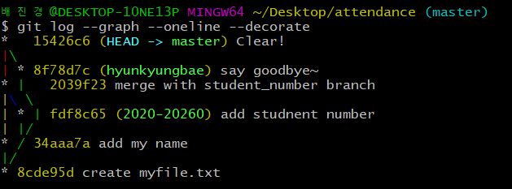
Attendance Check Coding (~17:30, Apr 10)
Capture the git history in tree style and rename the image like 20xx_xxxxx_log.png. (Refer to the image below)
Capture the text file(.txt) in the master branch and rename the image as 20xx_xxxxx_text.png.
Submit the zip file containing 2 images on ETL page.

Slide 32
Homework ( Due : Apr 17 15:30 pm)
Fork our repo, https://github.com/Yongil-Kim/PM-2019
Edit the PullRequest.txt && make a new Pull-Request to our repo(3 points)
The subtitle of Pull-Request is your student ID.
Clone your forked repo into your local workspace
Open ‘Homework.cpp’ and complete the code by following ‘TODO’ comment.
Upload .zip file containing only “Homework.cpp” to ETL (7 points)
Submission type : StudentID.zip (ex 2018-12345.zip)

Slide 33
Contacts (TA)
Main TA
Support TA
배현경 | hkbae@snu.ac.kr |  | jennybae1024@gmail.com
이윤형 | cpi1234@snu.ac.kr | cpi1234_1
이환희 | wanted1007@snu.ac.kr | gmpee7207
Notes:
Escape sequence: \를 앞에 붙여서 원래의 의미를 벗어나는 문자를 의미 (\r \\ \” 등)

Slide 34
Appendix
How to generate ssh key

Slide 35
Generate SSH Key
ssh-keygen -t rsa -b 4096 –C "your_email@example.com"
This command generates an ssh key pair, which is stored in ~/.ssh
An ssh key pair consists of private key and public key.
cd ~/.ssh
cat id_rsa.pub
This command prints the public key
You will enter this key on Github
eval $(ssh-agent –s)
ssh-add ~/.ssh/id_rsa
Add your private key in ssh-agent
https://jootc.com/p/201905122827

Slide 36
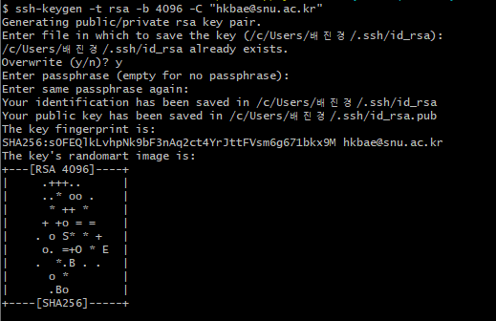
Generate SSH Key
ssh-keygen -t rsa -b 4096 –C "your_email@example.com"
https://jootc.com/p/201905122827

Slide 37
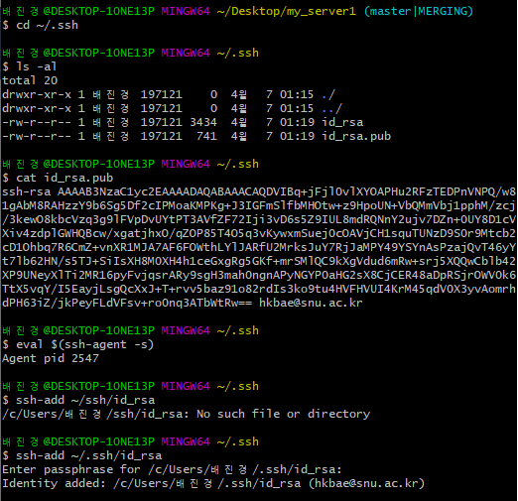
Generate SSH Key
cd ~/.ssh
cat id_rsa.pub
eval $(ssh-agent –s)
ssh-add ~/.ssh/id_rsa
https://jootc.com/p/201905122827

Slide 38
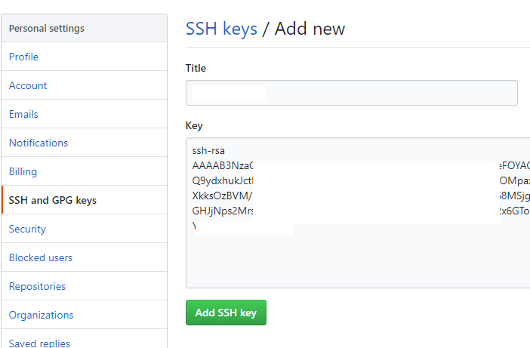
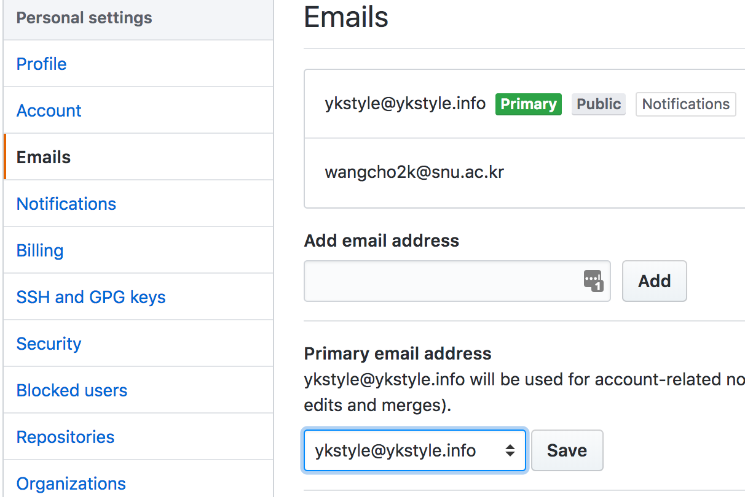
GitHub Setup
SSH keys / E-mails
Add your key to GitHub in account settings menu
Go to SSH and GPG keys, then select ‘New SSH Key’
Additional e-mail can be added in ‘Emails’ menu

